Slide 1

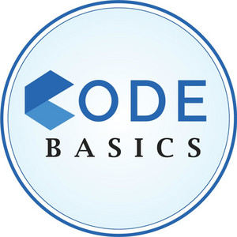
GOOD CABS PERFORMANCE REPORT
BY SANCHITA DASGUPTA

Slide 2
CONTENTS
PROBLEM STATEMENT
TOOLS & DATA USED
PRIMARY ANALYSIS
SECONDARY ANALYSIS
AD HOC REQUESTS
CONCLUSION & SUGGESTION

Slide 3

PROBLEM STATEMENT
Good cabs, a cab service company established two years ago, has gained a strong foothold in the Indian market by focusing on tier-2 cities. Unlike other cab service providers, Good cabs is committed to supporting local drivers, helping them make a sustainable living in their hometowns while ensuring excellent service to passengers. With operations in ten tier-2 cities across India, Good cabs has set ambitious performance targets for 2024 to drive growth and improve passenger satisfaction.
As part of this initiative, the Good cabs management team aims to assess the company’s performance across key metrics, including trip volume, passenger satisfaction, repeat passenger rate, trip distribution, and the balance between new and repeat passengers.
However, the Chief of Operations wanted this immediately so he decided to give this work to his team for analysis .

Slide 4
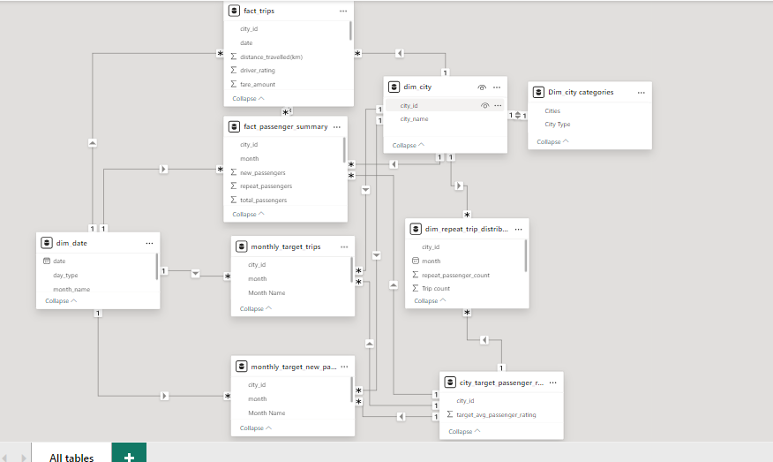


TOOLS & DATA USED
Data Analysis & Visualization
For solving AD hoc Requests

Slide 5
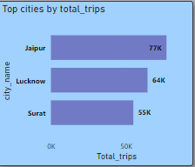
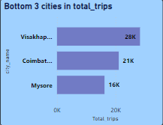
PRIMARY ANALYSIS
1.TOP & BOTTOM PERFORMING CITIES BY TOTAL TRIPS

Slide 6
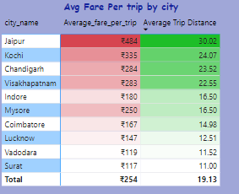
2.AVERAGE FARE PER TRIP BY CITY
Insights: Jaipur leads in average fare per trip at ₹484, with an average distance of 30.02 km. In contrast, Surat has the lowest fare at ₹117, with an average distance of 11 km.

Slide 7
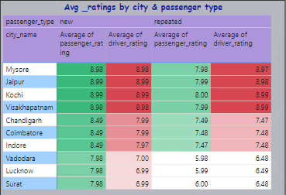
3.AVERAGE RATINGS OF PASSENGER & DRIVER BY CITY
Insights: Mysore leads with the highest ratings from both passengers and drivers, followed by Jaipur. Surat, however, records the lowest ratings in both categories

Slide 8
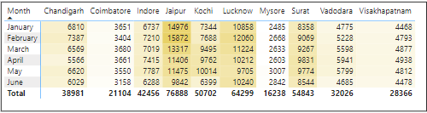
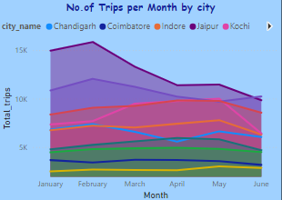
4.Highest & Lowest Peak By Months
Insights: Jaipur recorded the highest trips in January and February, driven by its pleasant late winter weather and popularity as a tourist destination. In contrast, Mysore consistently had the lowest trips across all six months.

Slide 9
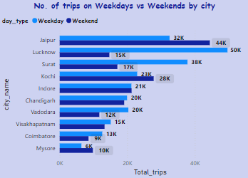
5.Weekend vs weekday Trip Demand By city
Insights: As per the resource, tourism-driven cities like Jaipur, Kochi, and Mysore see the highest number of trips during weekends, while business-centric cities such as Lucknow, Surat, and Vadodara experience peak trips on weekdays.
Source links:
Business Standard - Emerging Business Destinations
EY - GCCs Moving to Tier-2 Cities

Slide 10
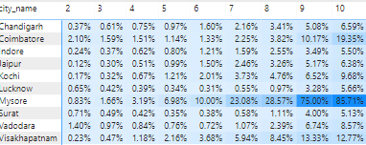
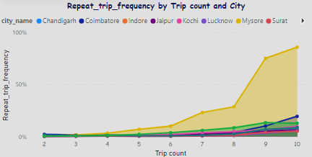
6.Repeat Passenger Frequency & city contribution analysis
Insights: Mysore has the highest repeat passenger frequency of 85.71% with 10 trips. Overall, Tourist show a higher repeat passenger frequency compared to business cities.

Slide 11
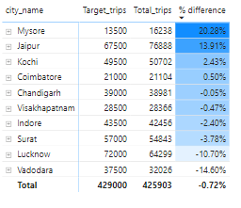
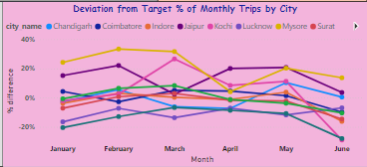
7.Monthly Target Achievement Analysis Against Key Metrics
Trips
Insights:
Mysore consistently exceeds the trips target overall and Vadodara being the lowest in achieving the target .

Slide 12
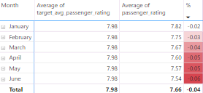
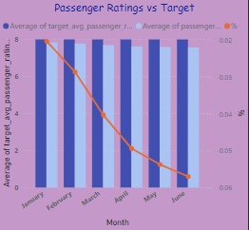
Average Passenger Ratings
Insights:
The highest variance difference is observed in June, while the lowest is in January.
Overall, the variance difference remains minimal.

Slide 13
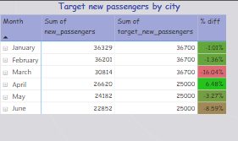
New Passengers
Insights:
April shows the highest success rate, exceeding the target.
March also demonstrates lowest performance in the six-month analysis.

Slide 14
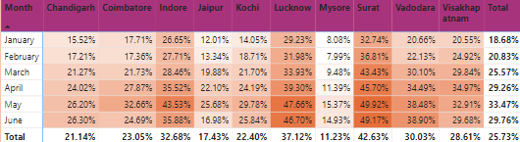
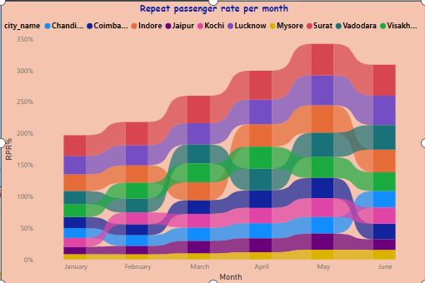
8.Highest and Lowest Repeat Passenger Rate (RRR%) By Month & City
Insights:
The highest RPR% is in May at 33.47%, while the lowest is in January at 18.68%.
City-wise, Surat leads with the highest RPR% at 42.63%, and Mysore has the lowest.

Slide 15


SECONDARY ANALYSIS
Based on the previous analysis, we found that Surat has the highest repeat passenger rate (RRR%), while Mysore has the lowest. A deeper analysis and comparison of these two cities reveal several factors influencing the RRR%.
Population Size:
Surat has a significantly larger population (8.33 million) compared to Mysore (1.27 million), contributing to higher RRR% due to a larger commuter base.
Income Levels & Seasonal Impact:
Surat's economy thrives year-round, driven by industries like textiles and diamonds.
Mysore, dependent on tourism and education, sees peak activity during winter but lower consistency throughout the year.
Cost of Living & Transport:
Surat offers affordable living costs and economical public transport.
Mysore has relatively higher living expenses and transport costs.
Housing & Social Structure:
Surat accommodates a transient, working-class population with practical housing solutions.
Mysore prioritizes heritage preservation and stable housing for a less transient community.
1.Factors Influencing Repeat Passenger Rate (RRR%)

Slide 16


2.Tourism Vs Business Impact
Based on our previous analysis, we observed that Jaipur experiences the highest number of trips, particularly during January and February, while Mysore has the lowest. Given that Mysore is a high-pricing city and is renowned for its Dasara festival (celebrated mainly in September and October), offering discounts during this period could help boost demand for quality cab services.
Additionally, business cities show a higher number of trips on weekdays compared to weekends. To address this, conferences and seminars could be organized on weekends to increase trip volume.
For tourism cities, cultural events and specific discounts could be offered to attract more customers on weekdays, helping to balance trip demand throughout the week.

Slide 17
3.Emerging Mobility Trends and Good cab's adaption
Opportunities for Good Cabs
Increased EV Adoption
FAME II subsidies drive EV growth, reducing fuel costs.
Greenhouse Gas Reduction
Carbon-neutral rides lower costs and support sustainability.
Evolving Consumer Preferences
Eco-conscious travelers seek green mobility options.
Tier 2 customers favor affordable, sustainable rides.
Digital Transformation
Smart features like carbon savings tracking enhance value.
Strategic Advantage
Adopting these trends will boost demand, ensure competitive pricing, and secure Good Cabs' market position.

Slide 18

4.Partnership Opportunities with Local Business
The rise of franchises such as Reliance Retail, Bata, and Tata Group in Tier 2 cities presents a significant opportunity for Good Cabs to establish partnerships with malls, IT sectors, and conference venues. In tourist-focused cities like Jaipur, where the demand for Good Cabs is already high, partnerships can be further expanded with hotels and tourist attractions.
One way to implement this is by offering mutual discounts: for example, malls could provide a 10% off coupon for customers who use Good Cabs, and Good Cabs could offer similar discounts for rides to those malls. This reciprocal arrangement would not only boost ride bookings but also enhance customer satisfaction and loyalty.
In business-centric cities like Vadodara, Surat, and Coimbatore, such initiatives could help improve passenger ratings and increase demand. To execute this effectively, detailed meetings of malls, conferences with stakeholders are essential to gather insights on customer footfall and demographics in these cities.

Slide 19
5.Data collection for Enhanced data driven decisions
While Good Cabs has performed well with existing metrics and data, incorporating additional data points could further enhance analysis and decision-making:
Feedback Data: Collect detailed customer feedback after each ride, including ratings for the driver and overall experience.
Travel Type: Analyze whether passengers are opting more for long-distance or short-distance trips.
Ride Completion Rates: Track the percentage of rides completed successfully without any issues.
Passenger Demographics: Gather data on the age, gender, and location of repeat passengers to better understand your customer base.

Slide 20
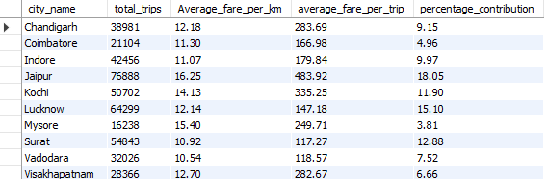
AD-Hoc REQUESTS
Request 1:City Level Fare & Trip Summary Report

Slide 21
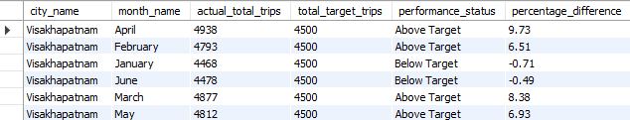
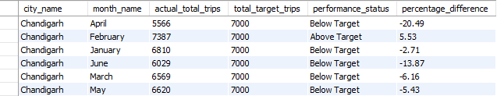
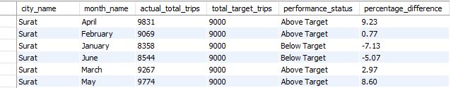
Request 2:Monthly City level Trips Target Performance Report

Slide 22
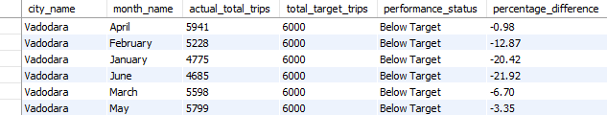
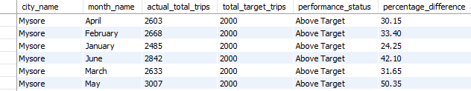
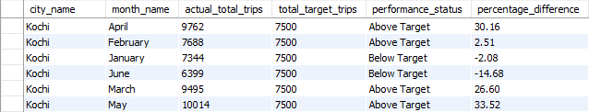
Request 2:Monthly City level Trips Target Performance Report

Slide 23
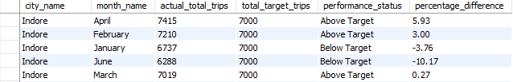
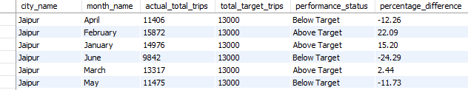
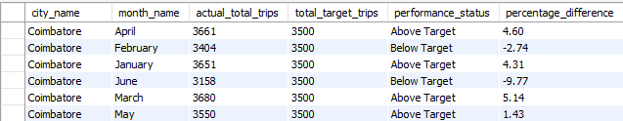
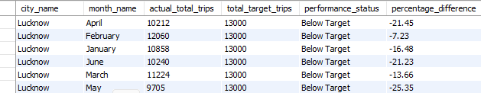
Request 2:Monthly City level Trips Target Performance Report

Slide 24
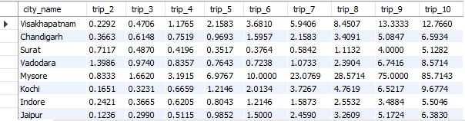
3.City Level Repeat Passenger Trip Frequency

Slide 25
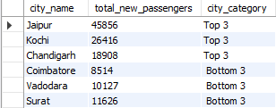
Request 4.Identify cities with Highest and lowest total new passengers

Slide 26
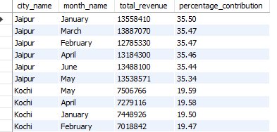
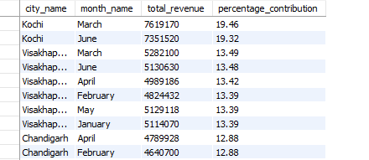
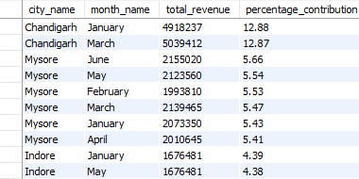
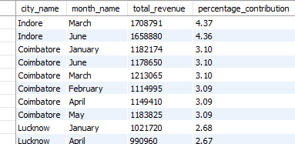
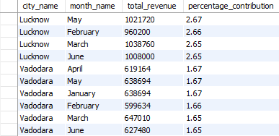
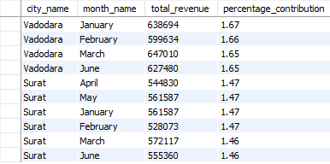
Request 5:Identify Month for highest revenue for each city

Slide 27
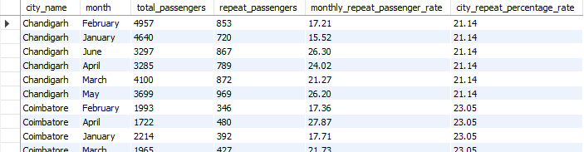
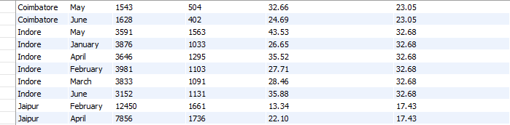
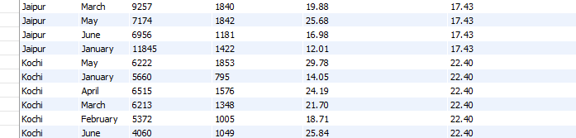
Request 6:Repeat Passenger Rate Analysis

Slide 28
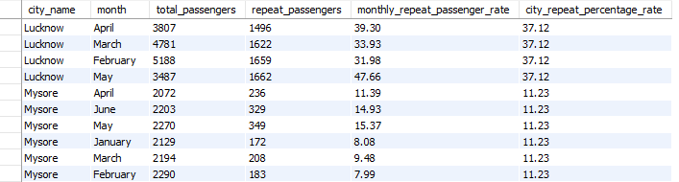
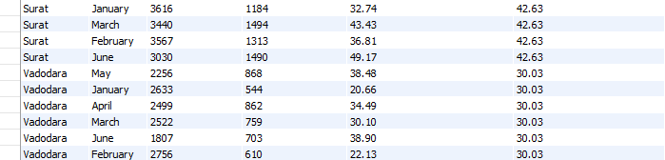
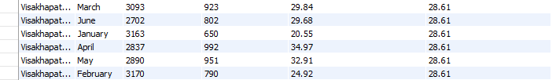
Request 6:Repeat Passenger Rate Analysis

Slide 29
CONCLUSION & SUGGESTION
Good Cabs has excelled in Tier-2 cities with strong passenger service and local driver support. By addressing seasonal demand gaps, leveraging business partnerships, and adapting to mobility trends, the company is poised to achieve its 2024 targets and enhance passenger satisfaction.
Promotions: Offer discounts during off-peak periods (e.g., weekdays for tourist cities, festivals in Mysore) to balance demand.
Partnerships: Collaborate with local businesses (e.g., malls, hotels) to drive mutual growth through shared discounts.
Emerging Trends: Embrace EV adoption and eco-friendly initiatives to appeal to sustainability-focused customers.
Enhanced Data: Collect detailed passenger demographics, ride feedback, and trip preferences for better decision-making.

Slide 30
Thank
You

